Slide 1



Slide 2



Slide 3

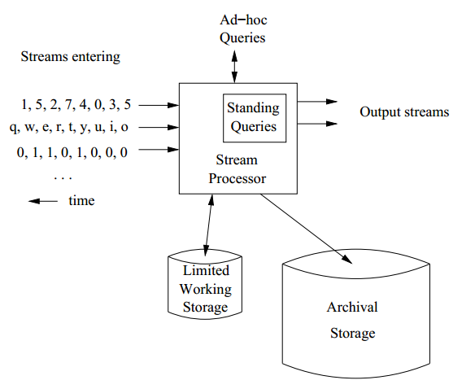


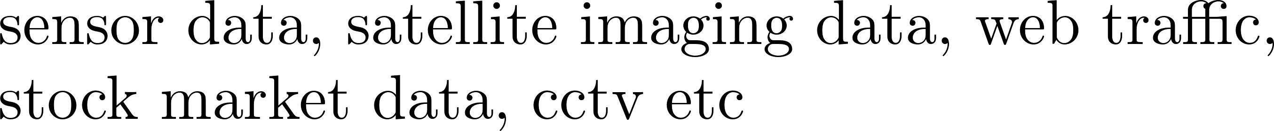

Slide 4

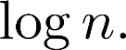
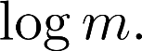

Slide 5
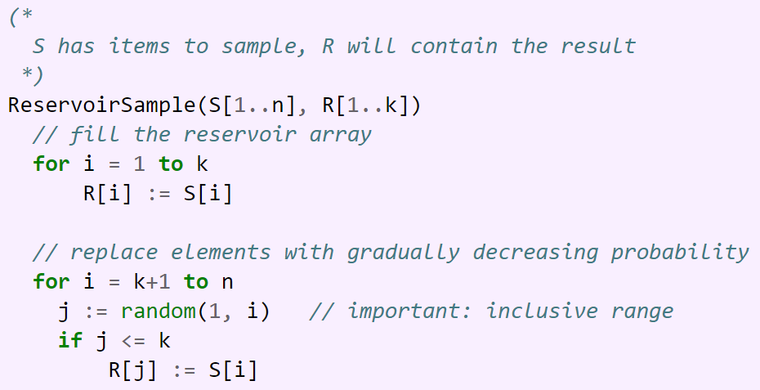

Slide 7


Slide 8
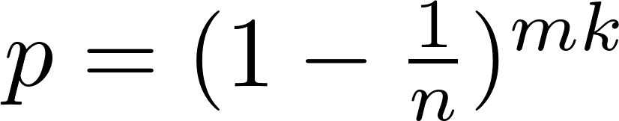
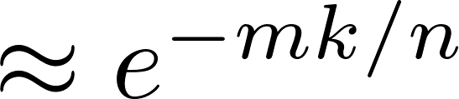
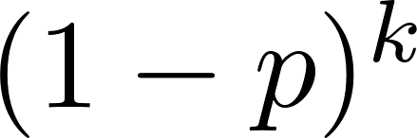
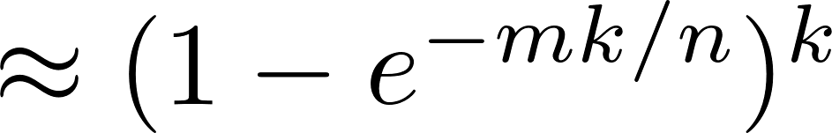

Slide 9
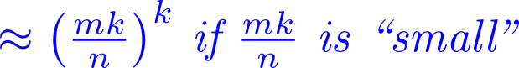
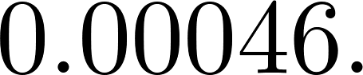

Slide 10

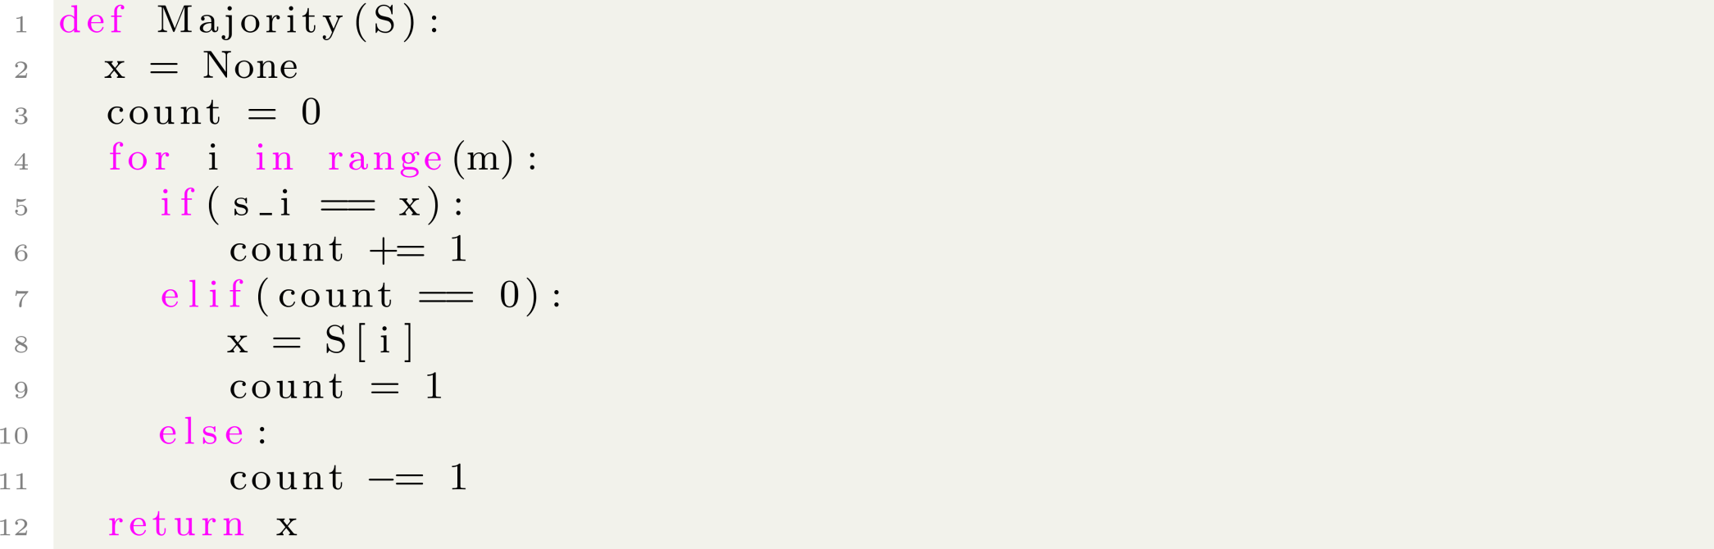
Notes:
Each decrement destroys the record of two elements, the current element and an existing element. This can only happens m/2 time. So, the majority element will have a record at the end.

Slide 11


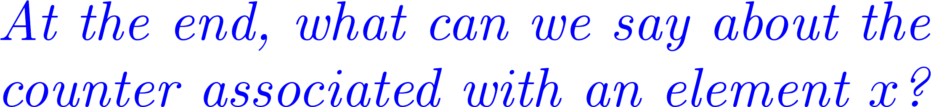

Notes:
If a counter is decremented, (k-1) counters are decremented and the current element’s count is not recorded. So, a decrement step destroys the record of k elements. This can happen only m/k times.
Thus all frequent elements have a record at the end.
At the end if we have a value t associated x then t lies between f_x – m/k and f_x.

